Slide 1
The Influence of Selection on Human cis-Regulatory Elements
Diego Rivera Gelsinger
Rotation #4
Dr. James Taylor’s Lab

Slide 2
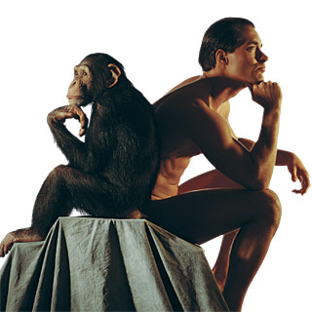
The 99.5%
Notes:
The chimpanzee has long presented a conundrum for human geneticists. The orthologous proteins of humans and chimpanzees are more than 99.5% identical [1], yet the two species differ profoundly across a broad spectrum of apparently unrelated phenotypes. This evident paradox led King and Wilson to speculate, famously, that differences in gene regulation, rather than protein-coding sequences, might primarily explain differences in physiology and behavior between humans and chimpanzees

Slide 3
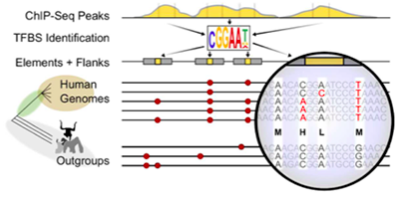
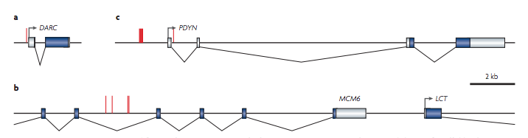
cis-Regulatory Elements
Duffy blood group
Cognitive Differences
Lactose tolerance
Notes:
It has long been argued that mutations affecting mechanisms of gene regulation must have had a prominent role in the evolution of humans and other mammals1, 2, 3. For several theoretical reasons, transcription factor binding sites and other cis-regulatory sequences may be particularly important in evolutionary adaptation4, 5, 6, 7. For example, mutations in such sequences might help to minimize the functional tradeoffs associated with evolutionary changes because these elements often primarily influence the expression of a single gene in a particular cell type or under a particular condition, whereas proteins tend to have broader effects. In addition, cis-regulatory mutations are often co-dominant (neither allele dominates), which may allow natural selection to act on them more efficiently than on protein-coding mutations.

Slide 4
Regulation of homologous genes drives divergence
Hypothesis: If regulatory machinery drives divergence between closely related species, we expect to find a high influence of natural selection in the sequence of non-coding regions of cis-regulatory elements.
Regions to study this can be transcription factor binding sites, histone methylation sites, and non-coding RNAs
Need interspecies variation and ancestral nucleotide state
Goal: Find differentially expressed homologous genes between Homo sapiens and non-human primates and infer the influence of selection on the regulatory regions of these genes

Slide 5
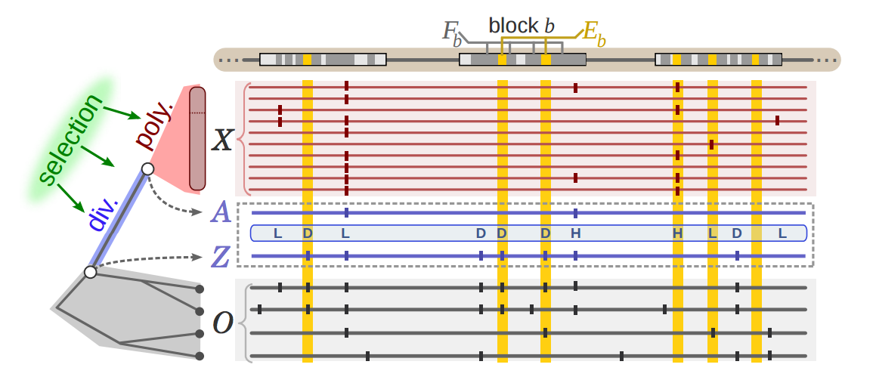
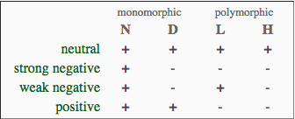
INSIGHT (Inference of Natural Selection from Interspersed Genomically coHerent elemenTs)
Notes:
The website also provides access to a server that can be used to run INSIGHT on any collection of human genomic elements, using our precomputed summaries of human polymorphism data

Slide 6
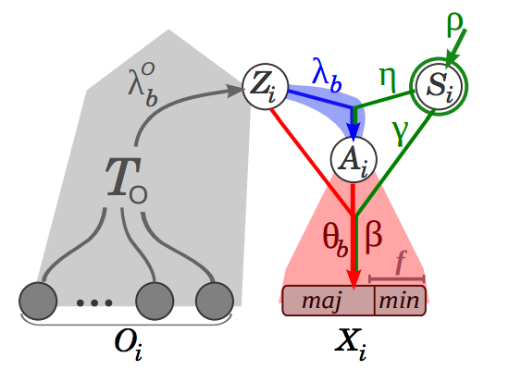
Probabilistic Method
Selection parameters
Divergence
Phylogenetic
Ancestry
Polymorphism
Notes:
INSIGHT infers signatures of recent natural selection from patterns of polymorphism and divergence across a collection of short dispersed genomic elements. The core of the method is a full probabilistic model that allows it to make use of sequence data across a dispersed set of elements to disentangle the effects of neutral genetic drift from positive, strong negative, and weak negative selection. INSIGHT provides estimates of three main measures: the fraction of nucleotides under selection (ρ), the number of divergences driven by positive selection (Dp), and the number of polymorphisms under weak negative selection (Pw).

Slide 7
Analysis Pipeline
RNA-seq
Differential Expressed Genes (Human genes relative to Chimp)
Statistically significant (False Discovery Rate < 5%)
Data
Filtering
Tissue-enriched genes (The Human Protein Atlas)
Down-regulated
Up-regulated
Data
Mining
cis-elements LINKED to a gene
DNaseI HSS specificity (ENCODE Project)
Natural
Selection
Analysis
INSIGHT
(precomputed summaries of human polymorphism on transcription
factor binding sites for 55 diverse human genomes)
ρ
Fraction of sites under
selection within
functional elements
E[A]
Sites under
positive selection
E[W]
Sites under
negative selection

Slide 8
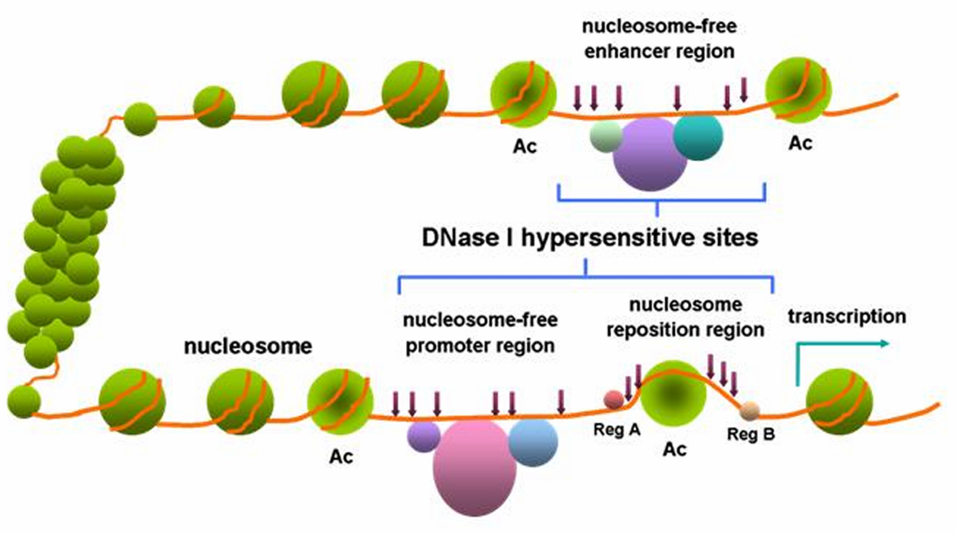
Dnase I hypersensitive sites are a sensitive measurement of promoter-enhancer sites
Distal
Proximal
Notes:
Find out how these sites were categorized as proximal vs distal
All DNase peaks from the above 14 cell lines were merged to form non­overlapping DNase­hypersensitive regions.
The merged DNase­hypersensitive regions were separated into TSS­proximal and TSS­distal groups based on whether or not they intersected a 2000­bp window centered on any GENCODE TSS (V19; gencode.v19.TSS.notlow.gff).
For each proximal and distal DNase­hypersensitive region, the DNase peak with the maximum score was labeled as a “master peak”
For each of the distal and proximal DNase master peaks, overlapping TF ChIP­seq peaks across all cell types (not restricted to above 14 cell lines) were identified. The TF peaks with maximum score in each master DNase peak

Slide 9
Differential Expression Analysis (Human relative to Chimpanzee)

Slide 10
Substantial Degree of Differential Expression in Muscle Tissue between Human and Chimp
Human changes relative to chimp

Slide 11
Larger Degree of Differentially Expressed Genes in the Prefrontal Cortex between Human and Chimpanzees
Human changes relative to chimp

Slide 12
Muscle Tissue Differential Expression Groups by Species
Chimp
Human

Slide 13
Prefrontal Cortex Tissue Differential Expression Groups by Species
Chimp
Human

Slide 14
Human Brain Tissue Exhibits More Up-regulation of Tissue-Specific Genes than Muscle Tissue
Up-regulated
Up-regulated
Down-
regulated
Down-
regulated

Slide 15
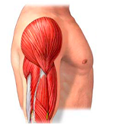
Influence of Selection on cis-Regulatory Elements of Muscle

Slide 16
Twice as Many Muscle-Enriched Genes are Up-regulated compared to Down-regulated

Slide 17
Proximal DNAseI HSS cis-Regulatory Elements (Promoters) of Down-Regulated Genes in the Human Muscle

Slide 18
Promoters of Down-regulated Muscle-specific Genes in Humans are Influenced by Negative Selection
ρ
E[A]
E[W]

Slide 19
Promoters of Down-regulated Genes in the Human Muscle are Under Selection

Slide 20
Adaptive Substitutions are Low in Promoters of Down-regulated Genes in the Human Muscle

Slide 21
Negative selection is more influential in down-regulated genes of the Human Muscle

Slide 22
Distal DNAseI HSS cis-Regulatory Elements (Enhancers) of Down-Regulated Genes in the Human Muscle

Slide 23
Enhancers of Down-regulated Muscle-specific Genes in Humans are Influenced by Negative Selection
ρ
E[A]
E[W]

Slide 24
Enhancers of Down-regulated Genes in the Human Muscle are Under Selection

Slide 25
More Adaptive substitutions in Enhancers of Down-regulated Genes in the Human Muscle

Slide 26
Wider Distribution of Negative Selection in Enhancers of Down-regulated Genes of the Human Brain

Slide 27
Proximal DNAseI HSS cis-Regulatory Elements (Promoters) of Up-Regulated Genes in the Human Muscle

Slide 28
Promoters of Down-regulated Muscle-specific Genes in Humans are Influenced by Negative Selection
ρ
E[A]
E[W]

Slide 29
Promoters of Up-regulated Genes in the Human Muscle are Under Selection

Slide 30
Adaptive substitutions are low in proximal DNAseI HS sites of down-regulated genes in the Human brain

Slide 31
Negative selection is more influential in Up-regulated genes of the Human Muscle

Slide 32
Distal DNAseI HSS cis-Regulatory Elements (Enhancers) of Up-Regulated Genes in the Human Muscle

Slide 33
Enhancers of Up-regulated Muscle-specific Genes in Humans are Influenced by Negative Selection
ρ
E[A]
E[W]

Slide 34
Enhancers of Up-regulated Genes in the Human Muscle are Under Selection

Slide 35
More Adaptive substitutions in Enhancers of Up-regulated Genes in the Human Muscle

Slide 36
Wider Distribution of Negative Selection in Enhancers of Up-regulated Genes of the Human Muscle

Slide 37
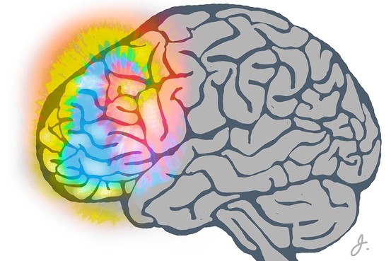
Influence of Selection on cis-Regulatory Elements of Prefrontal Cortex

Slide 38
Brain-Enriched Genes are Predominately Up-regulated in Humans compared to Chimpanzee

Slide 39
Proximal DNAseI HSS cis-Regulatory Elements (Promoters) of Down-Regulated Genes in the Human Prefrontal Cortex

Slide 40
Promoters of Down-regulated Brain-specific Genes in Humans are Influenced by Negative Selection
ρ
E[A]
E[W]

Slide 41
Promoters of down-regulated genes in the human brain are under selection

Slide 42
Adaptive substitutions are low in proximal DNAseI HS sites of down-regulated genes in the Human brain

Slide 43
Negative selection is more influential in down-regulated genes of the Human brain

Slide 44
Distal DNAseI HSS cis-Regulatory Elements (Enhancers) of Down-Regulated Genes in the Human Prefrontal Cortex

Slide 45
Enhancers of Down-regulated Brain-specific Genes in Humans are Influenced by Negative Selection
ρ
E[A]
E[W]

Slide 46
Enhancers of down-regulated genes in the human brain are under selection

Slide 47
More Adaptive substitutions in Enhancers of Down-regulated Genes in the Human Brain

Slide 48
Wider Distribution of Negative Selection in Enhancers of Down-regulated Genes of the Human Brain

Slide 49
Proximal DNAseI HSS cis-Regulatory Elements (Promoters) of Up-Regulated Genes in the Human Prefrontal Cortex

Slide 50
Promoters of Up-regulated Brain-specific Genes in Humans are Influenced by Positive Selection
ρ
E[A]
E[W]

Slide 51
Few Promoters of Up-regulated Genes in the Human Brain are Under Selection

Slide 52
Adaptive substitutions in Promoters of Up-regulated genes in the Human brain

Slide 53
Less Negative Selection in Promoters of Up-regulated Genes of the Human brain

Slide 54
Distal DNAseI HSS cis-Regulatory Elements (Enhancers) of Up-Regulated Genes in the Human Prefrontal Cortex

Slide 55
Enhancers of Up-regulated Brain-specific Genes in Humans are Influenced by Negative Selection
ρ
E[A]
E[W]

Slide 56
Enhancers of down-regulated genes in the human brain are under selection

Slide 57
More Adaptive substitutions in Enhancers of Up-regulated Genes in the Human Brain

Slide 58
Wider Distribution of Negative Selection in Enhancers of Up-regulated Genes of the Human Brain

Slide 59
Up-regulation Summary
Enhancers
Promoters
Muscle
Brain
Muscle
Brain
Muscle
Brain
Muscle
Brain
Notes:
More regulatory regions with positive selection in brain compared to muscle (both promoters and enhancers.

Slide 60
Down-regulation Summary
Enhancers
Promoters
Muscle
Brain
Muscle
Brain
Muscle
Brain
Muscle
Brain

Slide 61
Acknowledgements
Taylor Lab
Mike Sauria
Nitesh
Enis
Dr. James Taylor
YUE Lab
ENCODE Project
INSIGHT-EM Team

Slide 62
Questions?

Slide 63
Regulatory elements of differentially-expressed genes in the human brain are under selection
ATP1A3
CAMK2A
LSAMP
C1orf61
PMP2
SLC1A2
KIAAO408
CPLX2
NMNAT2
KIAA1644
NECAB1
CDK5R2
B3GAT1
OPCML
NAP1L5
TNR
CACNG3
KCNJ6
C1orf95
IL17D
CALN1
GALNT9
KCTD16
SPOCK1
PACSIN1
SHC3
SYT7
SHISA9
NPTXR

Slide 64
Adaptive substitutions in proximal DNAseI HS sites tends to be in upregulated genes
CDK5R2
KCNJ6
TNR
NAP1L5
CACNG3
OPCML
CPLX2
CAMK2A
IL17D
NECAB1
SPOCK1
LSAMP
CALN1
SLC1A2
ATP1A3
C1orf61
PMP2
KIAAO408
NMNAT2
KIAA1644
B3GAT1
C1orf95
GALNT9
KCTD16
PACSIN1
SHC3
SYT7
SHISA9
NPTXR
---- = > 2-fold up-regulated gene
---- = < 2-fold up-regulated gene
---- = Down-regulated gene
E[A] per kilobase (Number of fixed differences due to positive selection)

Slide 65
B3GAT1
NAP1L5
C1orf95
CACNG3
CALN1
TNR
IL17D
SLC1A2
ATP1A3
KIAAO408
OPCML
C1orf61
SHC3
CAMK2A
LSAMP
PMP2
CPLX2
NMNAT2
KIAA1644
NECAB1
CDK5R2
KCNJ6
GALNT9
KCTD16
SPOCK1
PACSIN1
SYT7
SHISA9
NPTXR
---- = > 2-fold up-regulated gene
---- = < 2-fold up-regulated gene
---- = Down-regulated gene
E[W] per kilobase (Number of polymorphic sites subject to weak negative selection)

Slide 66
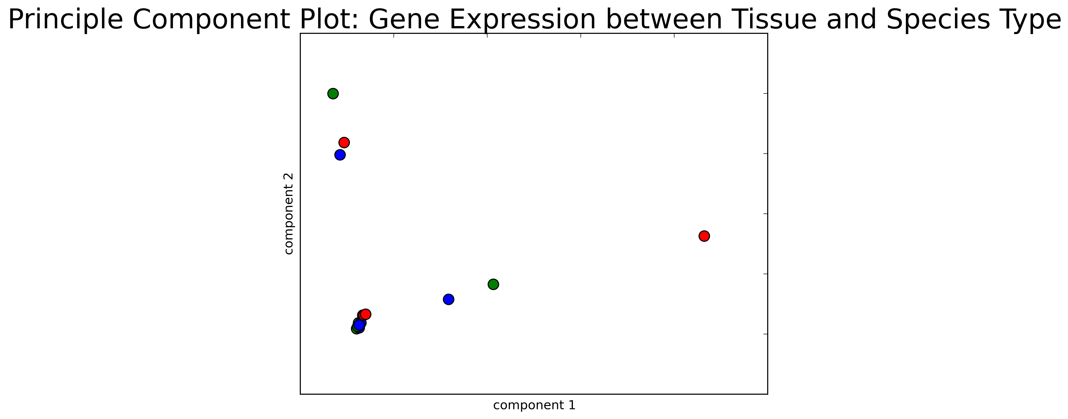
Tissue Type Gene Expression is the Principle Component in Expression Abundance
Human
Muscle Tissue
Chimp
Rhesus Monkey
Kidney Tissue
Brain Tissue

Slide 67
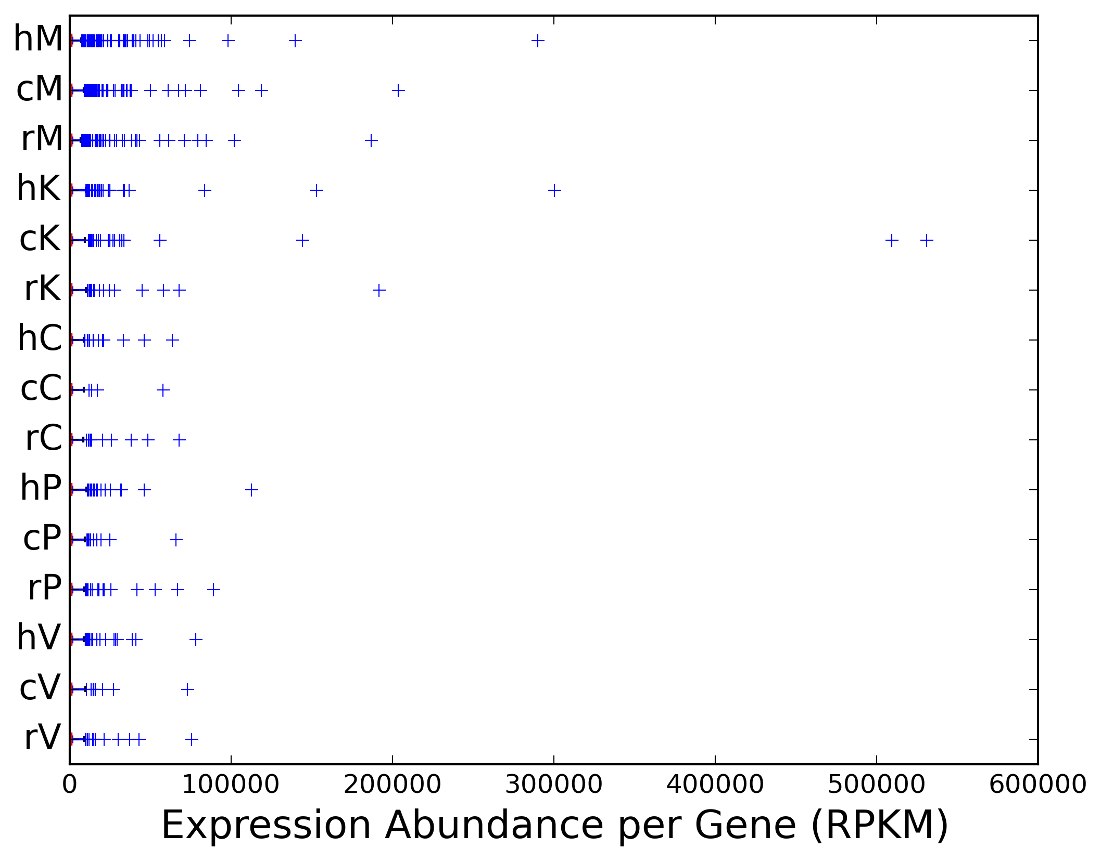
Gene Expression Abundance Distribution by Tissue Type
Muscle
Kidney
Cerebellar
Cortex
Prefrontal
Cortex
Primary Visual
Cortex

Slide 68
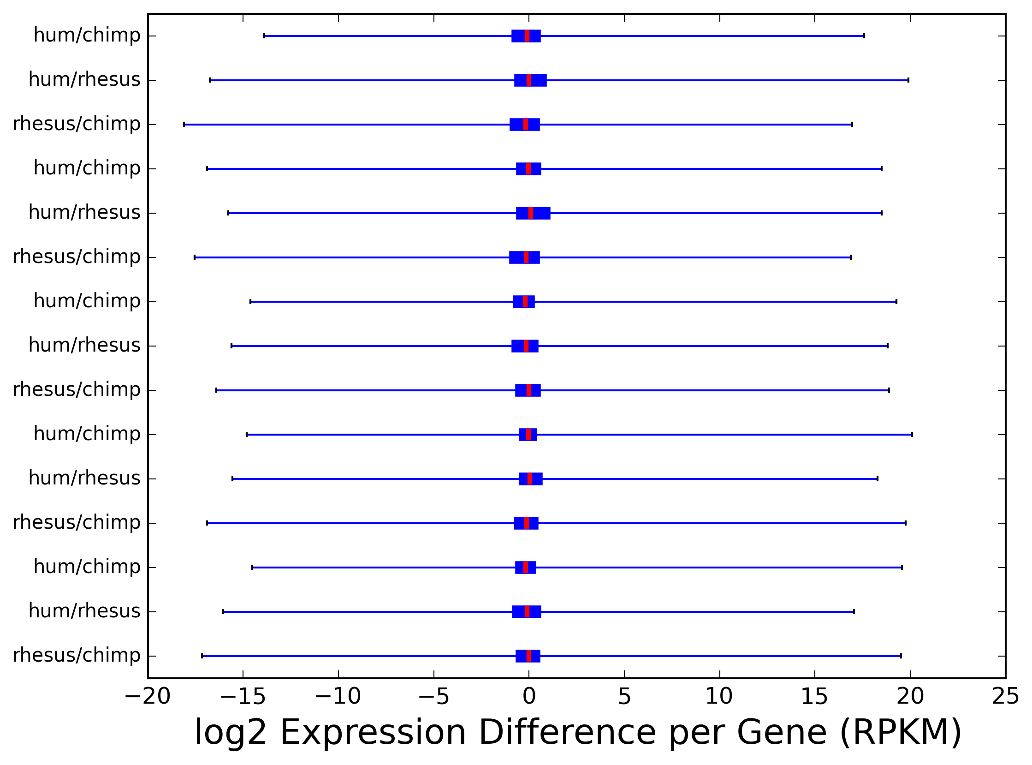
Gene Expression Difference Distribution by Tissue Type
Muscle
Kidney
Cerebellar
Cortex
Prefrontal
Cortex
Primary Visual
Cortex

Slide 69
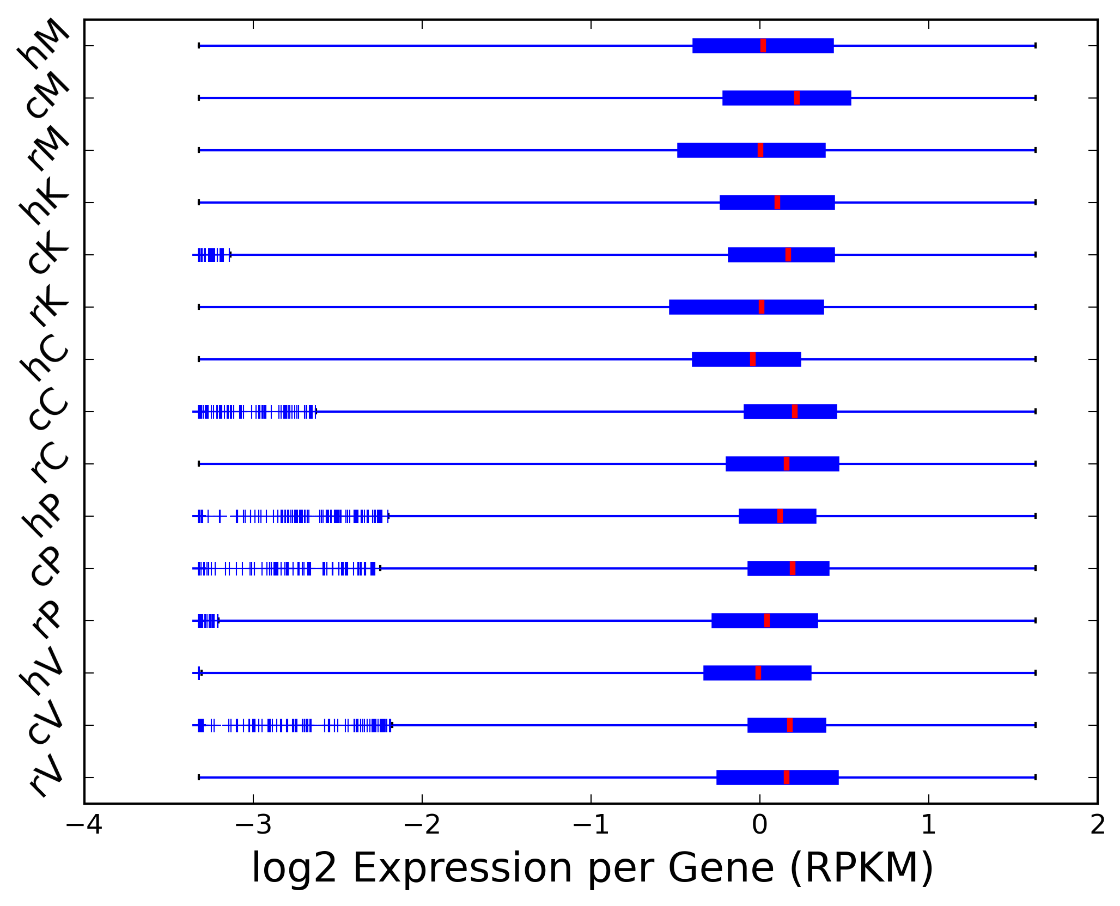
Average Normalized Gene Expression Distribution by Tissue Type
Muscle
Kidney
Cerebellar
Cortex
Prefrontal
Cortex
Primary Visual
Cortex

Slide 70
Muscle

Slide 71
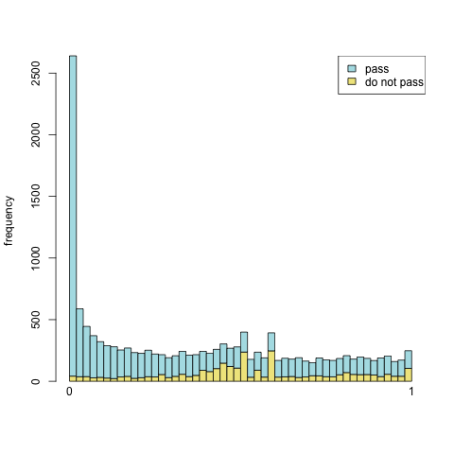
Muscle

Slide 72
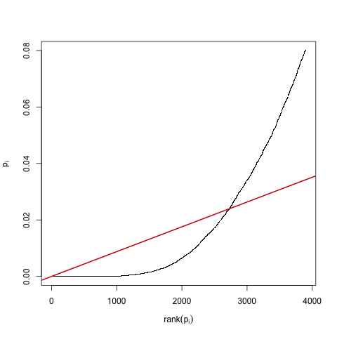
Muscle

Slide 73
Prefrontal Cortex

Slide 74
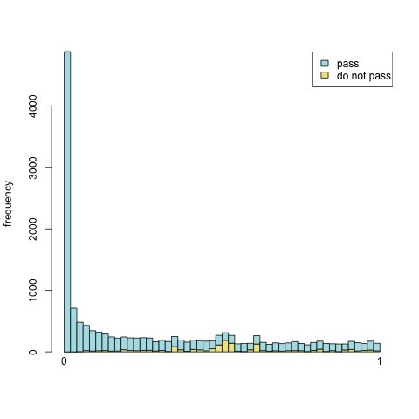
Prefrontal Cortex

Slide 75
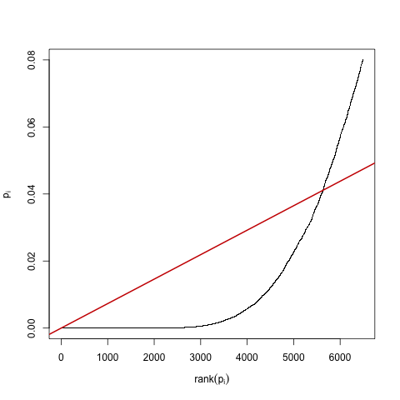
Prefrontal Cortex

Slide 76
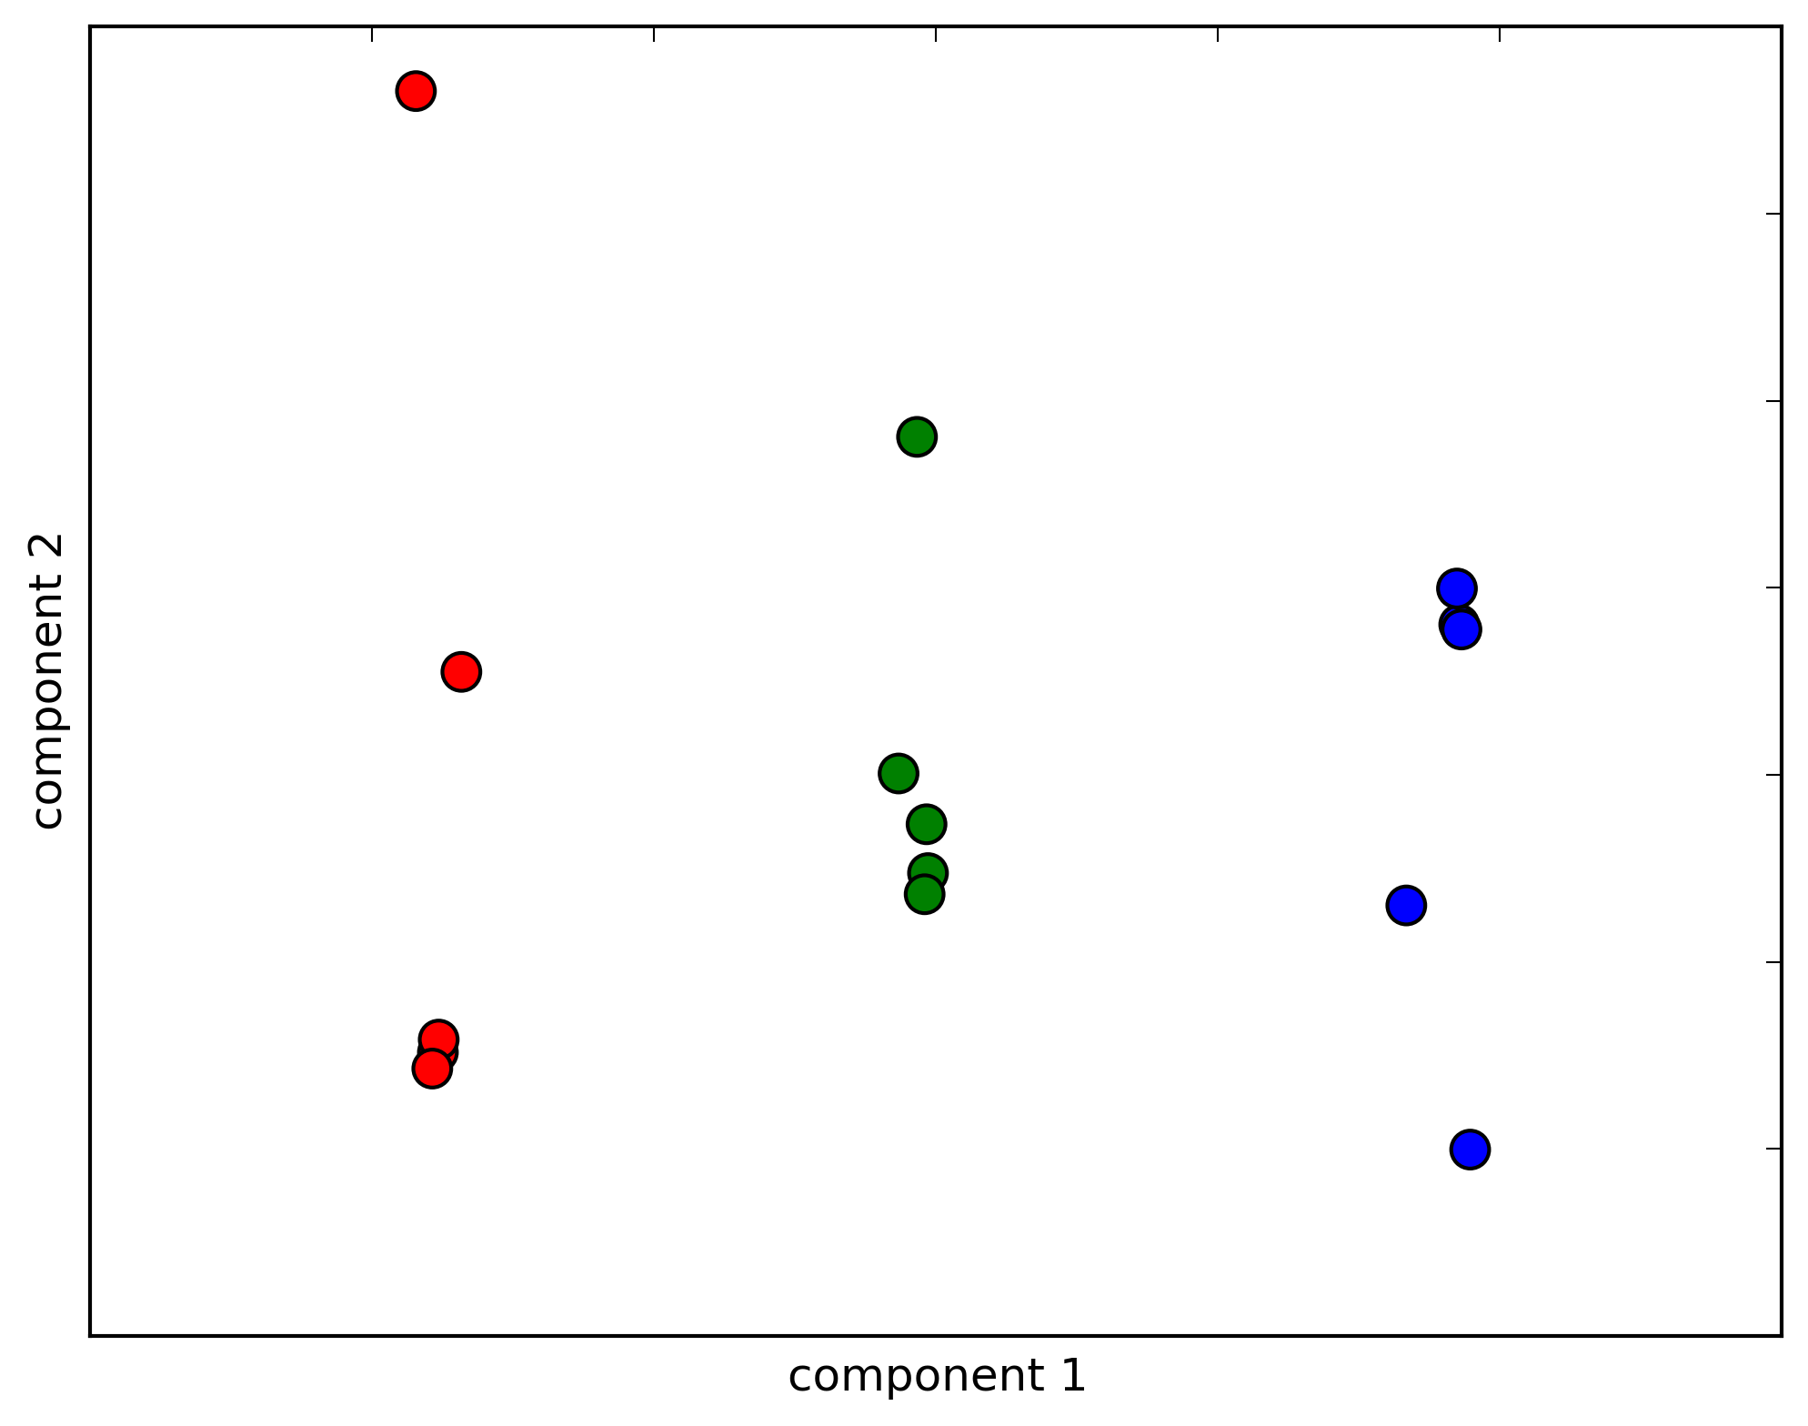
Species Gene Expression is the Principle Component in Differential Expression
All Tissues: Diff. Exp.
Human/Rhesus Monkey
Human/Chimp
Human/Rhesus
Rhesus/Chimp
All Tissues: Diff. Exp.
Rhesus Monkey/Chimp
All Tissues: Diff. Exp.
Human/Chimp

